Slide 1
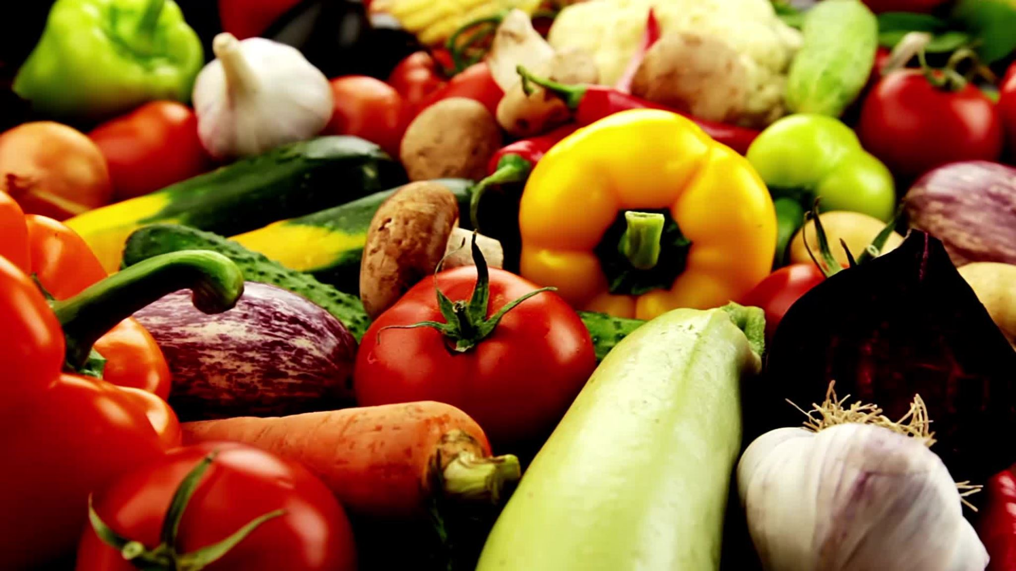

SpeedyGrouve: Integrated Grocery Management System

Slide 2
TEAM MEMBERS
AKASH - C0910253
SAKSHI - C0908000
PRANIT - C0913039
JAGADEESH - C0912884

Slide 3

About Speedy Gro
Speedy Gro is a rapidly growing online grocery delivery service that connects customers with fresh groceries, delivered to their doorstep.
The company aims to provide a fast, reliable, and seamless shopping experience with a wide selection of products.

Slide 4

Problem Statement
As demand increases, Speedy Gro needs a robust data system to manage its operations efficiently.

Slide 5
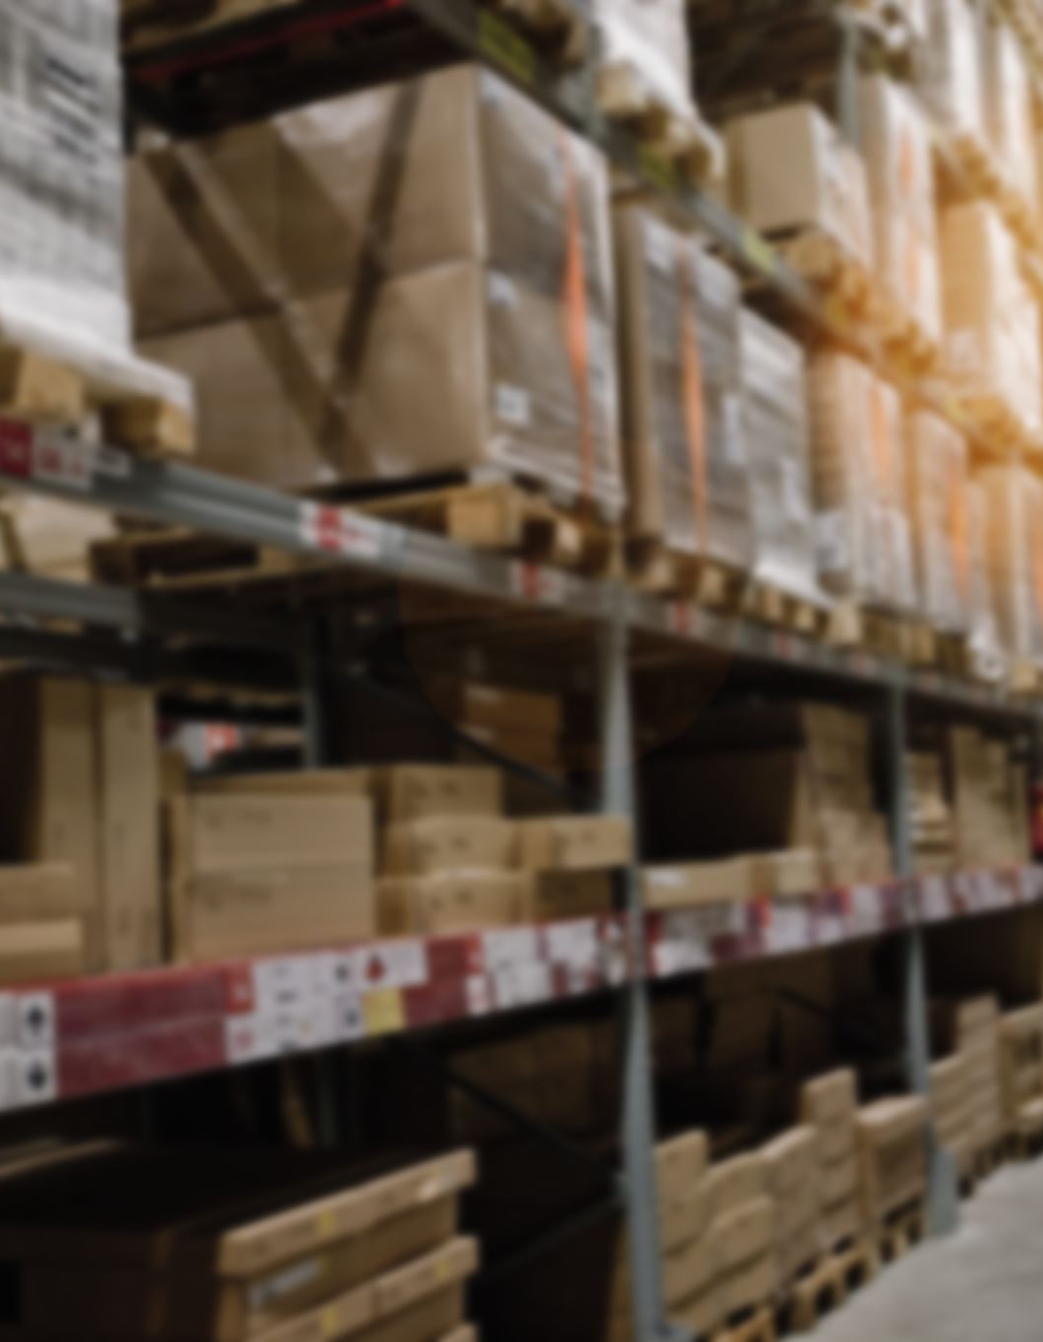
The Need for a Solution
A structured data model will help optimize Speedy Gro’s operations.
It will enable real-time tracking, better order management, and accurate inventory control.
A data-driven system ensures faster deliveries, efficient warehouse management, and happier customers!

Slide 6
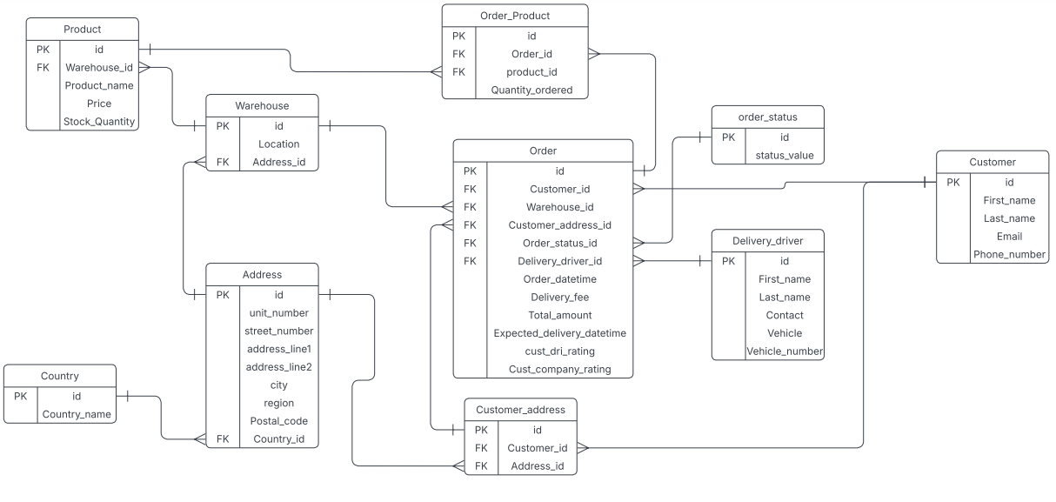
Designing-Data-Model-for-Speedy-Gro

Slide 7
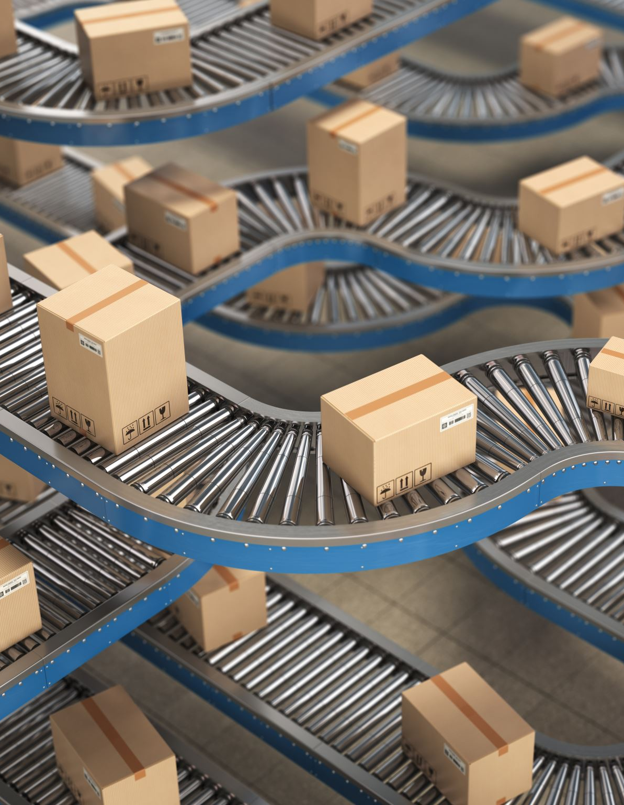
Overview of the ERD
Purpose: This ERD represents a delivery management system, illustrating the entities and their relationships.
Key Components:
Product and warehouse details.
Customer information and delivery tracking.
Order processing and status management.

Slide 8
Key Entities and Attributes
Product:
Attributes: id, Warehouse_id, Product_name, Price, Stock_Quantity.
Customer:
Attributes: id, First_name, Last_name, Email, Phone_number.
Order:
Attributes: id, Customer_id, Warehouse_id, Order_datetime, Total_amount, Expected_delivery_datetime.
Address:
Attributes: id, unit_number, street_number, city, region, Postal_code, Country_id.

Slide 9
Relationships Between Entities
Product and Warehouse:
Each Product is stored in a Warehouse, creating a One-to-Many relationship where a warehouse stocks multiple products.
Order and Customer:
Order and Product:
Each Order can contain multiple Products, and each Product can be part of multiple Orders, making this a (Many-to-Many relationship), which is managed through the Order_Product table
Delivery Driver:
The Order is assigned to a single Delivery Driver, while each driver can handle multiple orders (One-to-Many relationship).
A Customer can place multiple Orders, but each Order belongs to a single Customer (One-to-Many relationship).

Slide 10
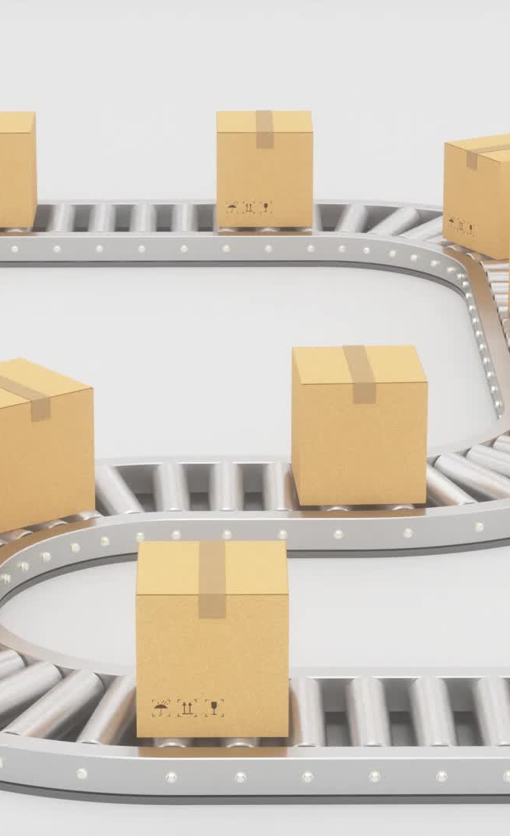
Workflow and Business Logic
Customer Places Order:Links to customer and delivery addresses.
Warehouse and Product Check:Stock validation against Stock_Quantity.
Order Fulfillment:Delivery assigned to a driver and tracked using order_status.
Feedback Mechanism:Ratings for drivers and companies (cust_dri_rating, Cust_company_rating).

Slide 11
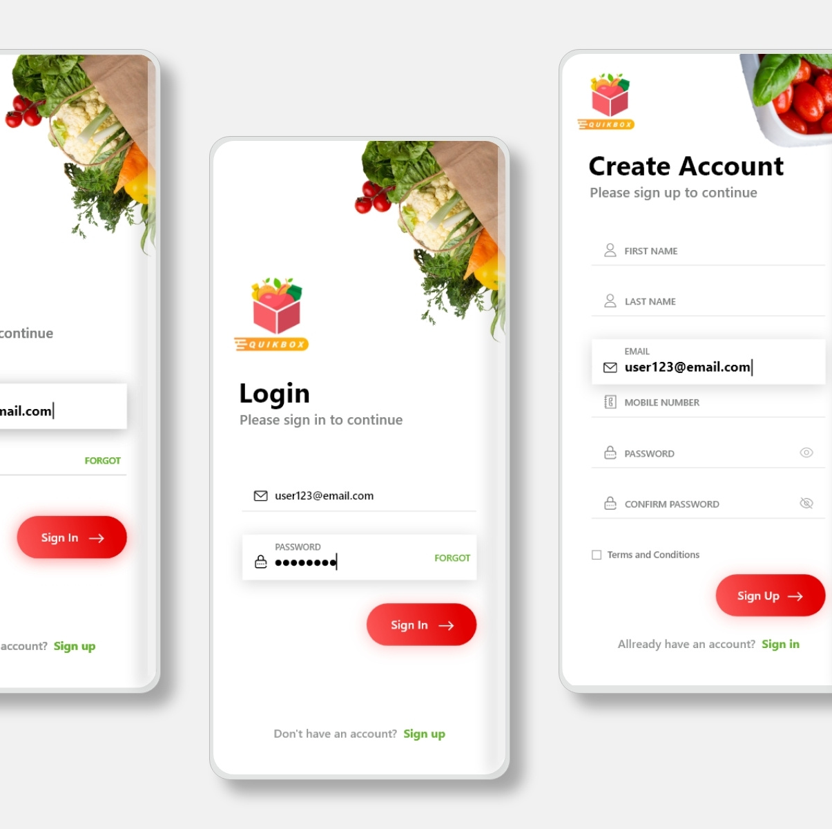
Log in page
The customer opens the application.
After opening, the login page is displayed.
Once the username and password are entered, the application opens.

Slide 12

User interface
It displays all the grocery items in the application.
User select the items user wants to buy

Slide 13
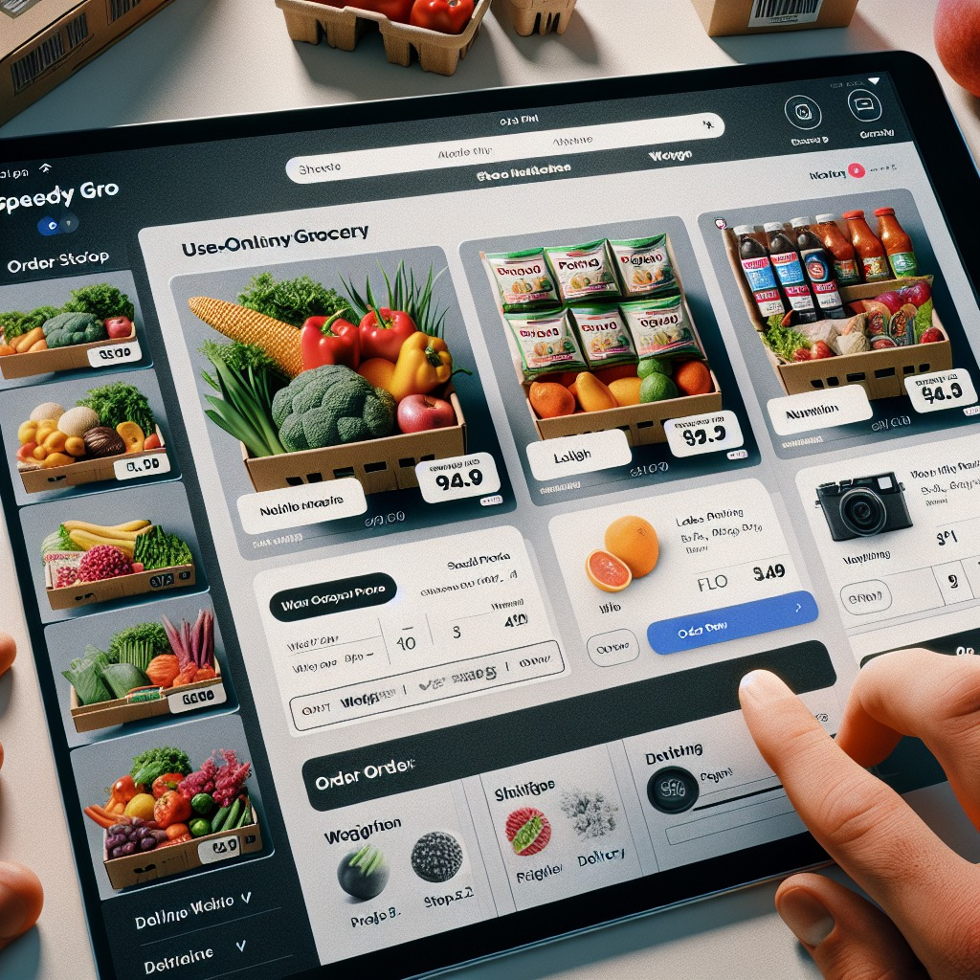
Choosing the grocery items
The customer selects the items based on their interests.
After selecting all the items, they proceed to place the order.

Slide 14
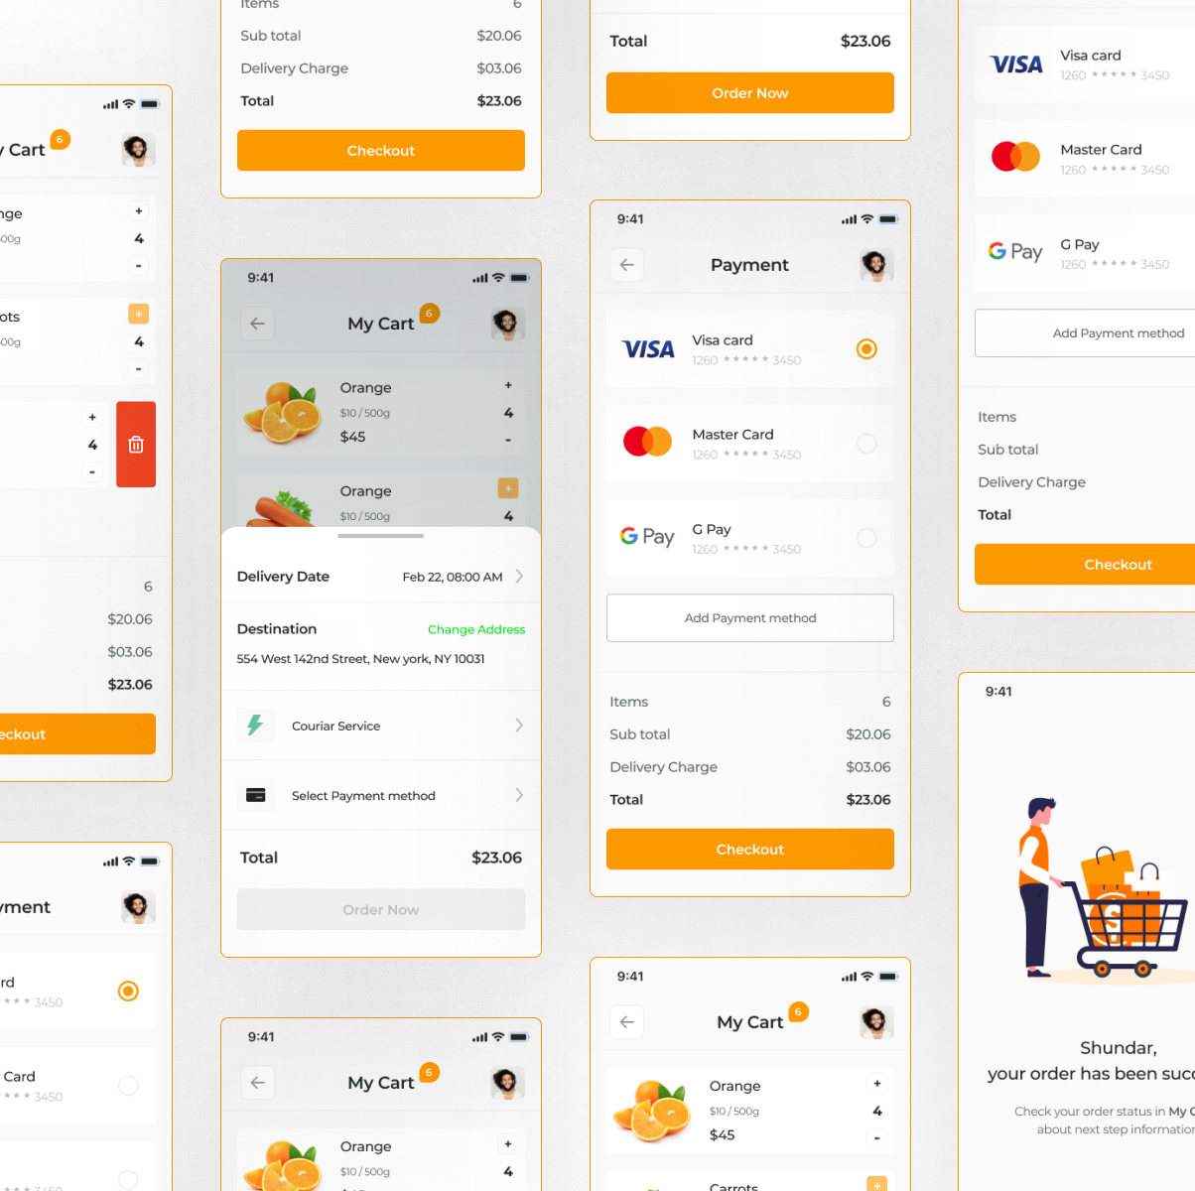
Payment page
After placing the order now customers will be directed to payment page
Here, we did take the payment aggregators platforms like
Visa,Mastercard,etc .

Slide 15
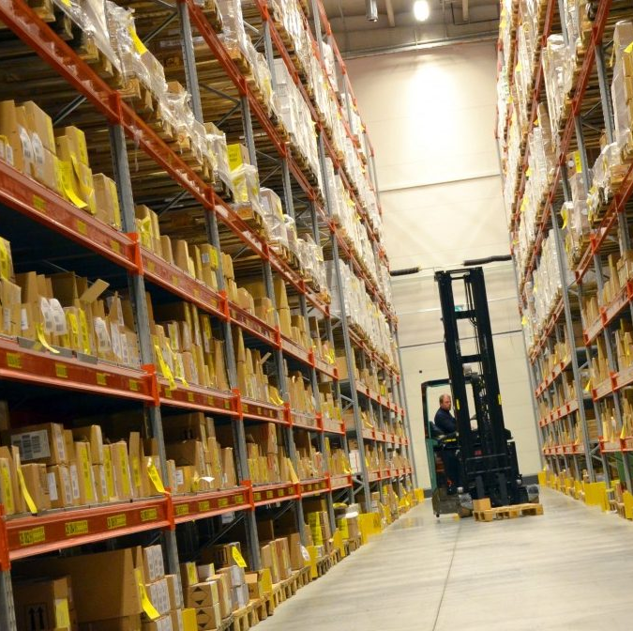
Inventory Check & Picking
The order is transmitted to the warehouse, where the items are picked and packed.
The system checks inventory, and warehouse staff picks the items from shelves."

Slide 16
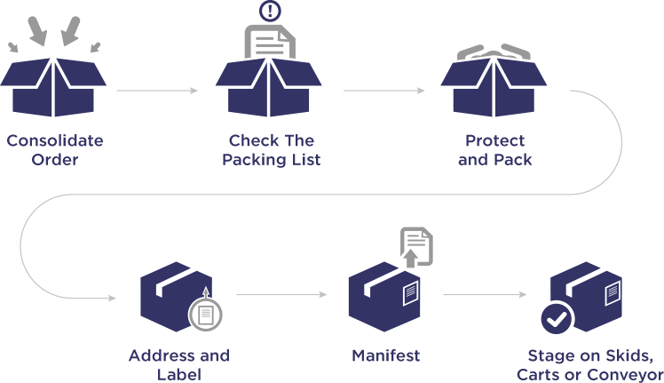
Order Fulfillment Process Flow: From Consolidation to Staging

Slide 17
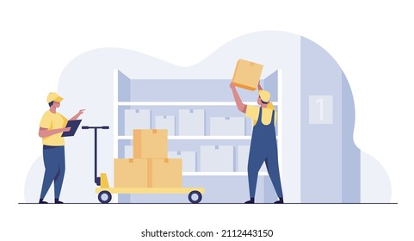
Order Handoff to Delivery Driver

Slide 18
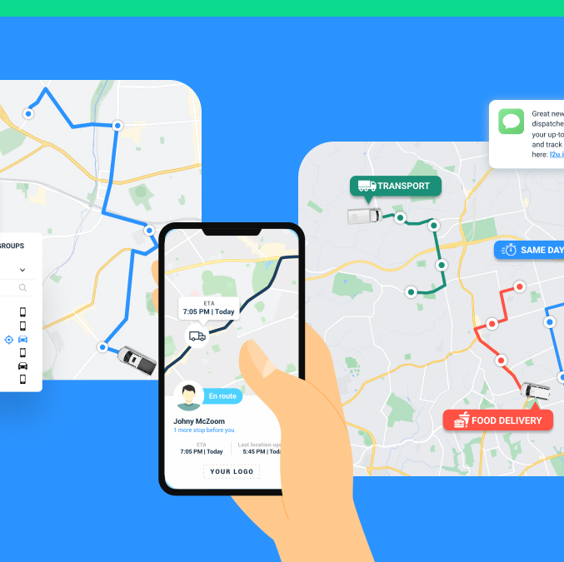
Real-Time Delivery Tracking
Customers can track the delivery in real-time through the app for better visibility."

Slide 19
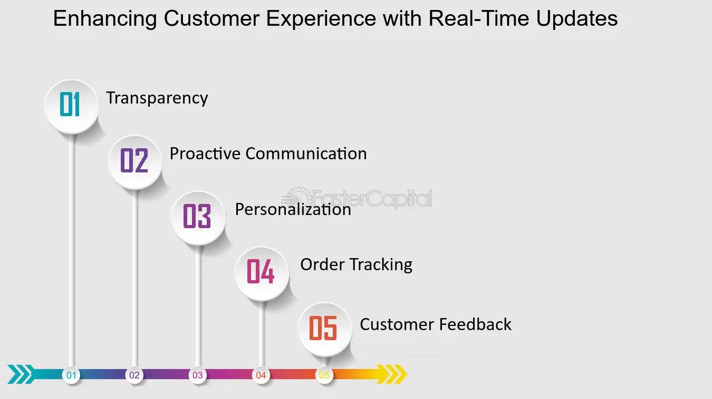
Key Process Flow
Builds trust through transparency and proactive communication, leading to personalized order experiences and tracking capabilities
Customer Engagement Cycle

Slide 20
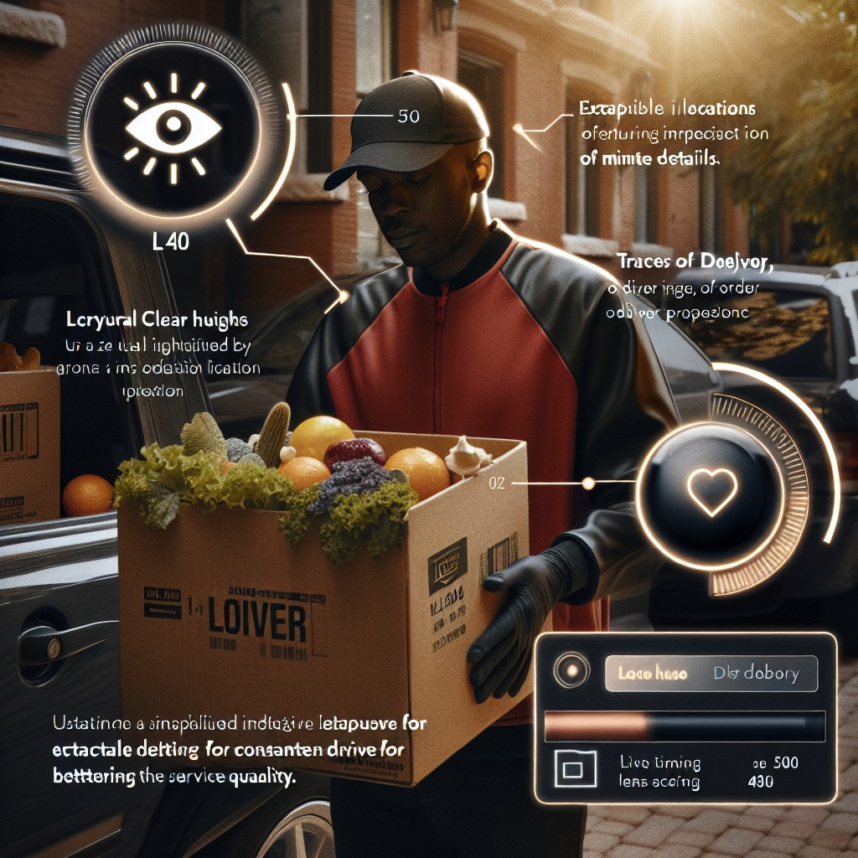
Arrival & Delivery at Customer's Doorstep
Once the customer receives the order, they confirm delivery
The driver arrives at the customer’s location and delivers the groceries

Slide 21

Order Completion & Feedback
Once the customer receives the order, they confirm delivery and leave a rating or feedback

Slide 22

Conclusion
we designed a conceptual data model that enhances Speedy Gro’s operational efficiency by addressing:
Real-time Tracking – Ensuring efficient monitoring and optimized routing for delivery drivers.
Customer Order Management – Storing and managing customer preferences for a seamless shopping experience.
Inventory Monitoring – Keeping track of stock levels across multiple warehouses to prevent shortages and delays.

Slide 23

THANK YOU

